Slide 1


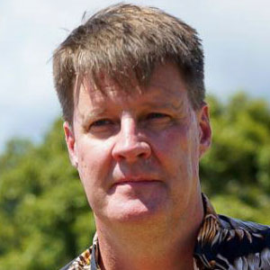

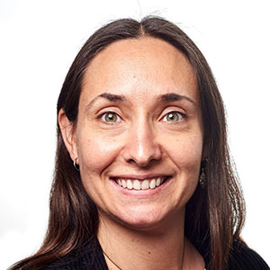
Roundtable introduction
WELCOME!
@EcoCommonsAus
An introduction to species distribution modelling in R
at EcoCommons
Dr Emilia Decker (she/her) Support and Training E: support@ecocommons.org.au
T: @EcoCommonsAus
@Em_DeCoeur
Dr Rob Clemens (he/him)
Change & Communications E: comms@ecocommons.org.au
T: @EcoCommonsAus
@RobertSClemens1
Dr Elisa Bayraktarov (she/her) Program Manager
E: manager@ecocommons.org.au
T: @EcoCommonsAus
@ElisaBayra
Notes:
Welcome to the workshop: Using the BCCVL to solve environmental problems, brought to you by the EcoCommons program
Firstly, as we gather for this workshop dispersed across many physical locations, I would like to take a moment to acknowledge the various traditional owners of the lands on which we meet, including the the Traditional Custodians of the ACT, the Ngunnawal people where I am today. I acknowledge the Elders – past, present and emerging of all the lands that we work and live on, and recognise their extraordinary contributions to the cultural, economic and scientific domains that we will discuss today.

Slide 2

Overview
What is Species Distribution Modelling?
Critical things to consider other than the workflow
Demonstration of point-and-click dashboard

Slide 3



@EcoCommonsAus
Notes:
We would like to acknowledge the Traditional Custodians of the land on which we are meeting - that's the Jagera and Turrbal peoples where I currently am. We pay my respect to the Elders, past and present, and extend that respect to all Aboriginal and Torres Strait Islander people.
We would acknowledge the Traditional Owners and their custodianship of the lands on which we meet today and pay my respect to their Ancestors and their descendants.

Slide 4











Vision: Australian practitioners and researchers to use trusted, world-leading ecological and environmental modelling tools to protect and restore the planet.
Mission: To be the platform of choice to analyse and model ecological and environmental challenges.
EcoCommons received investment from the Australian Research Data Commons (ARDC). The ARDC is funded by the National Collaborative Research Infrastructure Strategy (NCRIS).
Notes:
The EcoCommons is a partnerships program between 9 partner organisations.
We are building: A trusted single platform for ecological and environmental modelling & analysis - our mission is to build the platform of choice for environmental problem solving. The program will run for at least 3 years, so that’s between 2020 and 2023.
As we are building EcoCommons to become a National Research Infrastructure, our vision is to empower Australian practitioners and researchers to use trusted, world-leading ecological and environmental modelling tools.

Slide 5
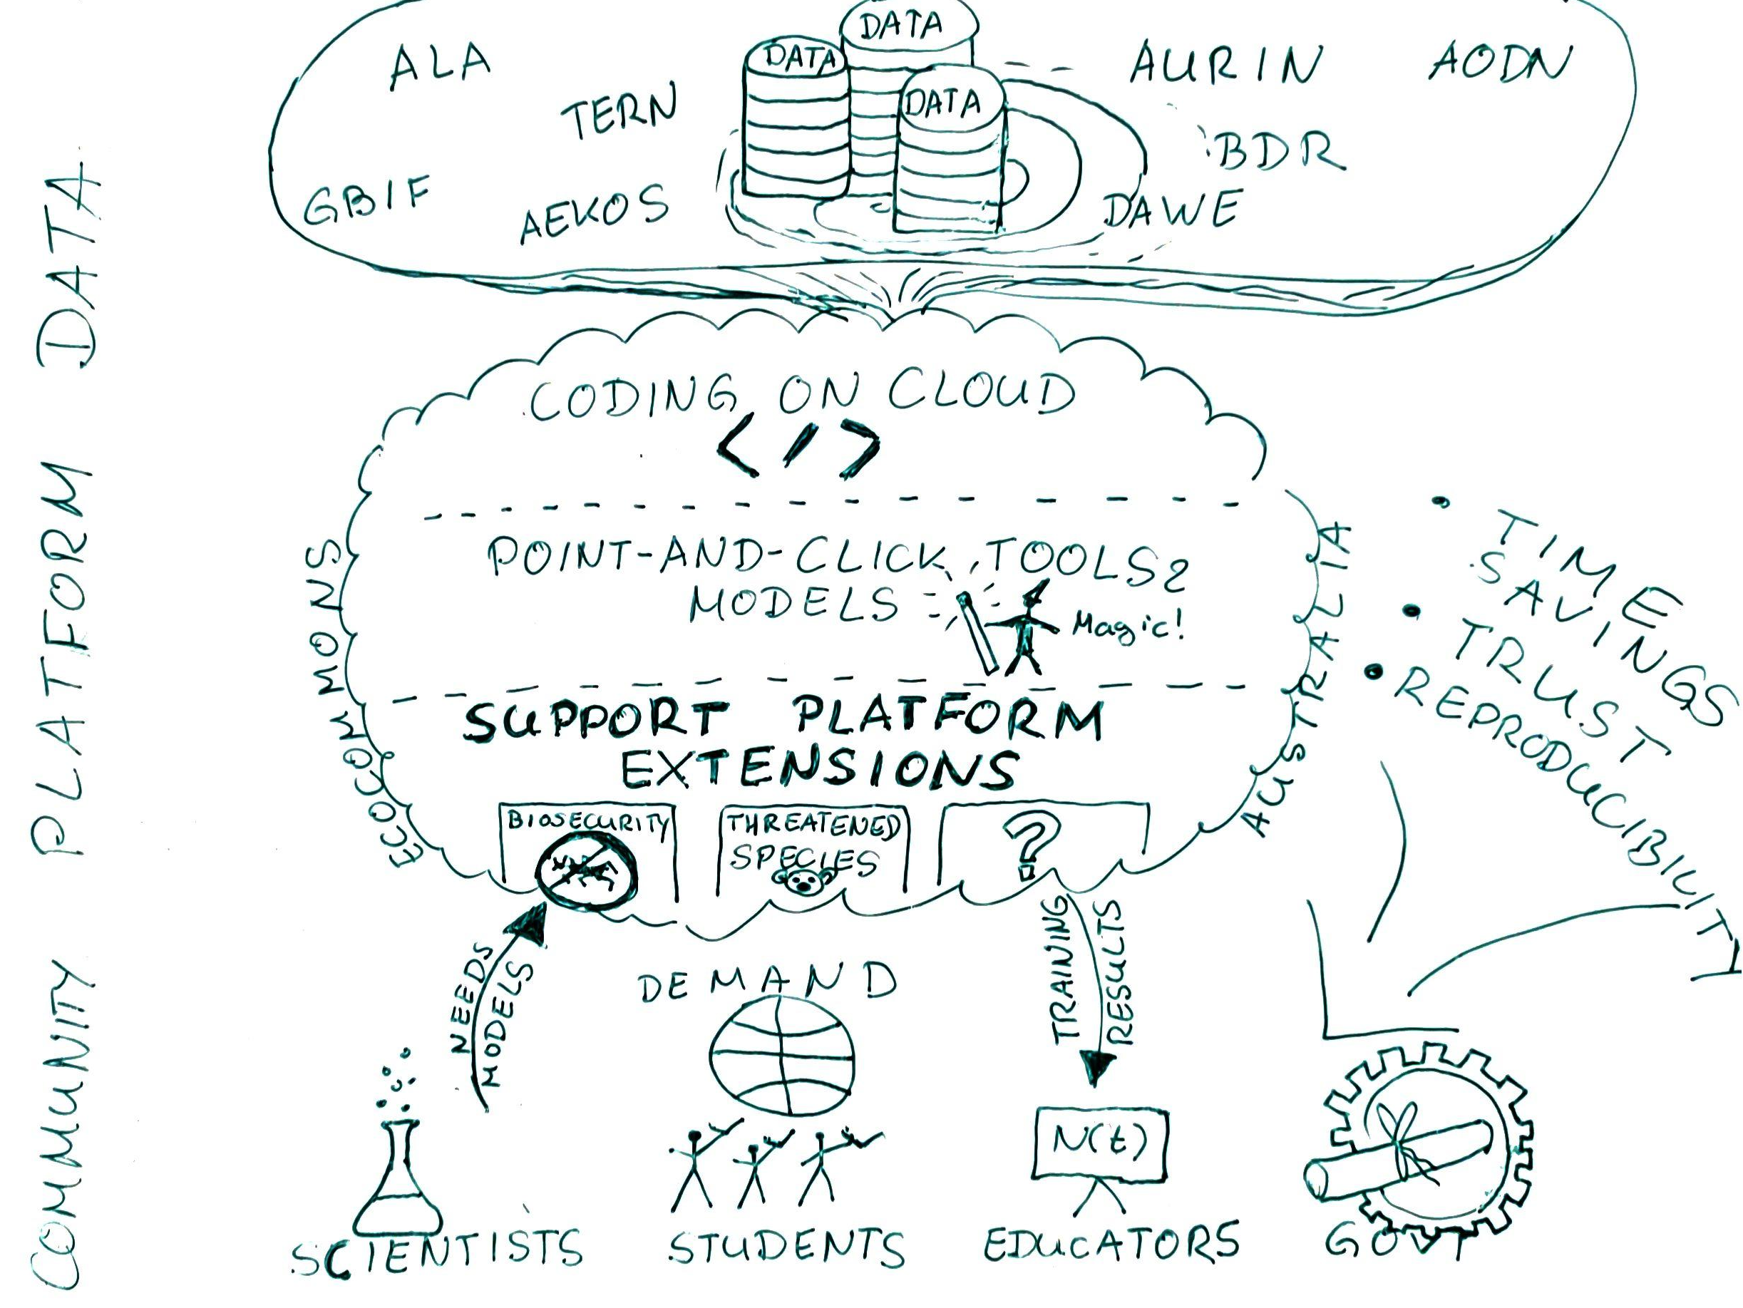
Why building it?
What does it do?
Who will it benefit?
Public release of EcoCommons in Nov 2022
Notes:
Elisa
For the benefit of Pete, who might not be very familiar with the EcoCommons, I’d like to give you a bit of a high-level description of the platform and its value proposition.
Please bear with my Napkin Drawing - we are planning to turn this into a more intricate infographic next month.
We’re building EcoCommons because we are passionate about empowering researchers and decision makers to protect and restore the planet.
EcoCommons is rapidly becoming a National Research Infrastructure that connects ecological data with robust scientific workflows to solve environmental challenges. Therefore we draw on the expertise of our many partners and collaborating top scientists.
With EcoCommons, you can either code on the cloud without the need of any expensive equipment or setup. If you don’t bring any coding or stats skills with you, you can quickly turn noisy data into high quality results in an easy-to-use point and click environment
You don’t have to worry if you don’t know where to begin your modelling journey, as we will offer you training and example code to get you started.
What many don’t know about EcoCommons is that it’s being built on a flexible architecture which can be used to fuel other projects. EcoCommons offers its platform foundation as a service, so it can be customised to support new platform extensions such as the Biosecurity Commons.
If you are a researcher, student, educator or policy-decision maker, you will gain the biggest benefits from EcoCommons as it will give you enormous time savings in getting from data to high impact results that people trust in. Another big benefit is that anything you do on EcoCommons is reproducible and can be shared with colleagues.

Slide 6

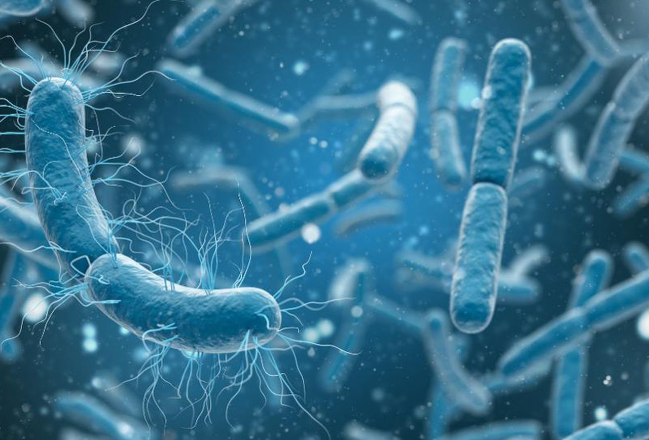
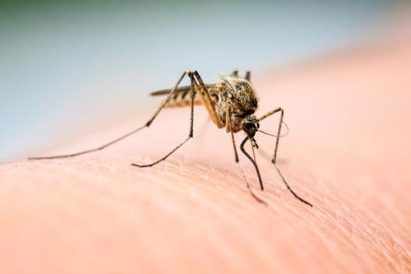
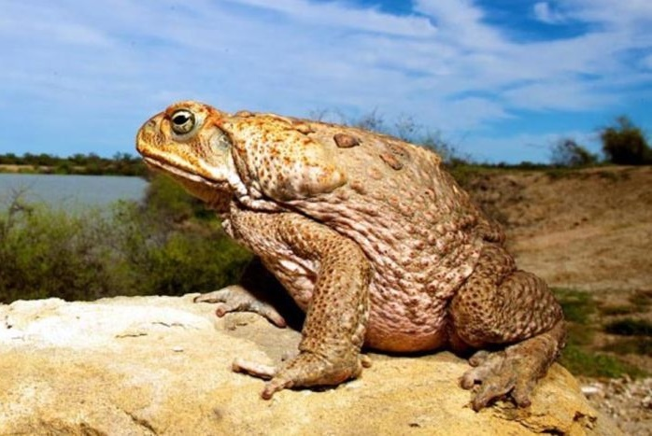


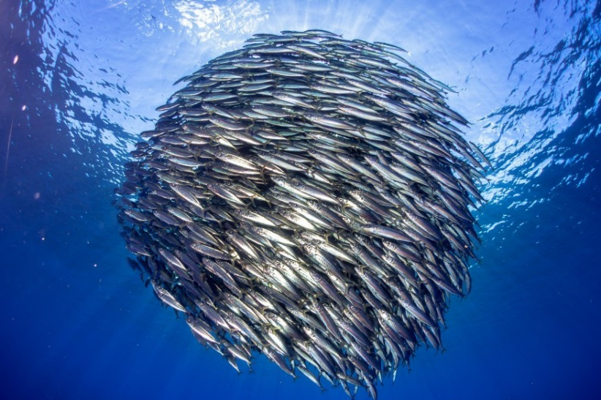
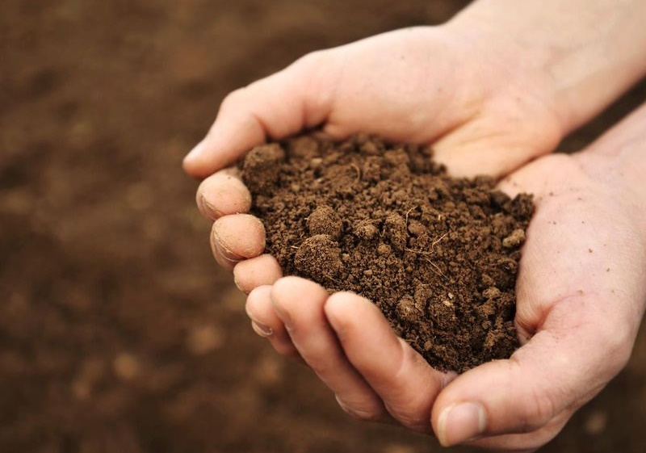
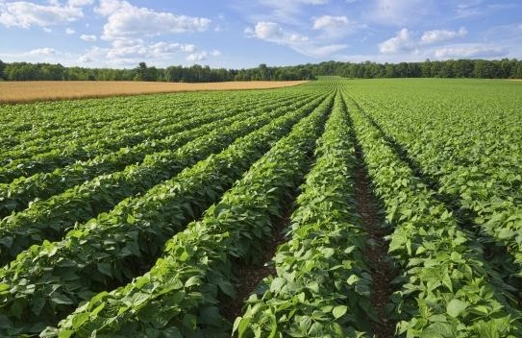

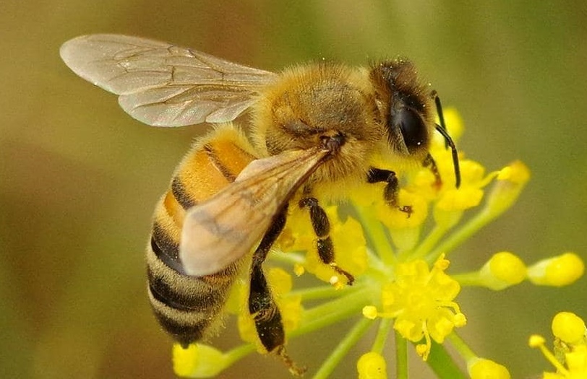
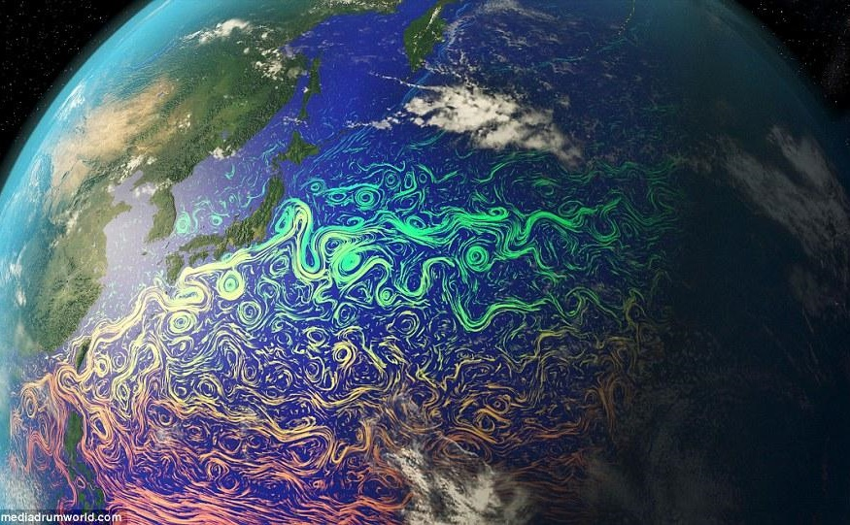
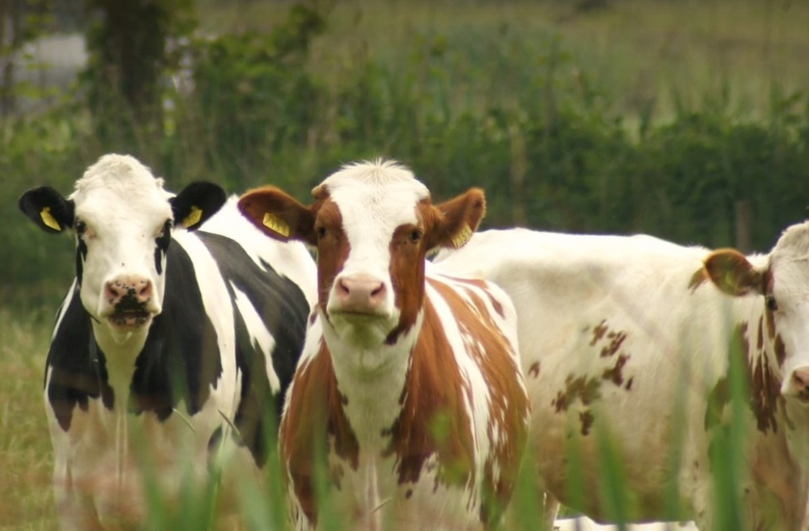
We support environmental problem solving
Notes:
So essentially at EcoCommons, we support environmental problem solving.
We do this by partnering up with research, government and industry to provide seamless access to biodiversity data + as well as tools for analysis and training for researchers and practitioners in Australia by building virtual laboratories for this purpose.
.

Slide 7

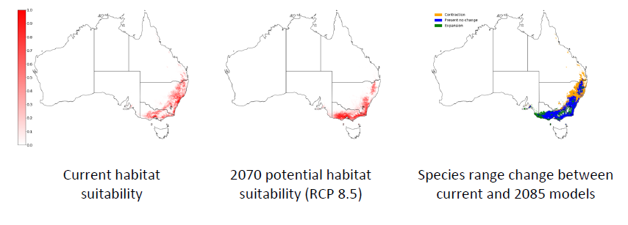
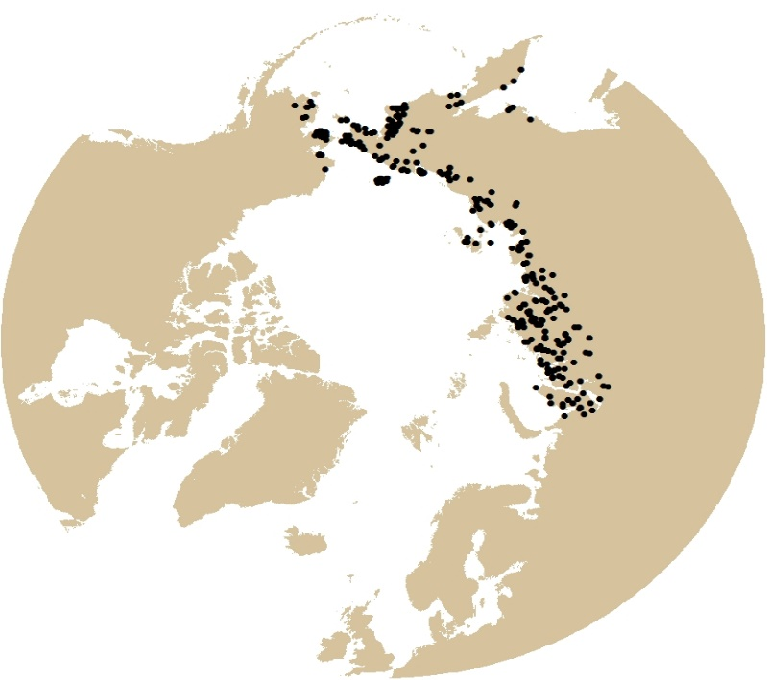
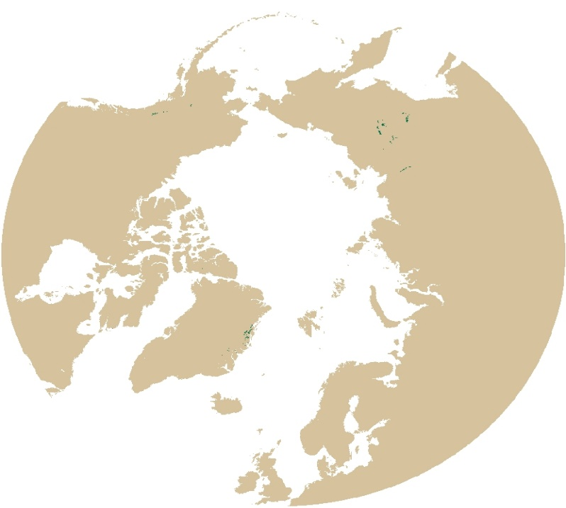
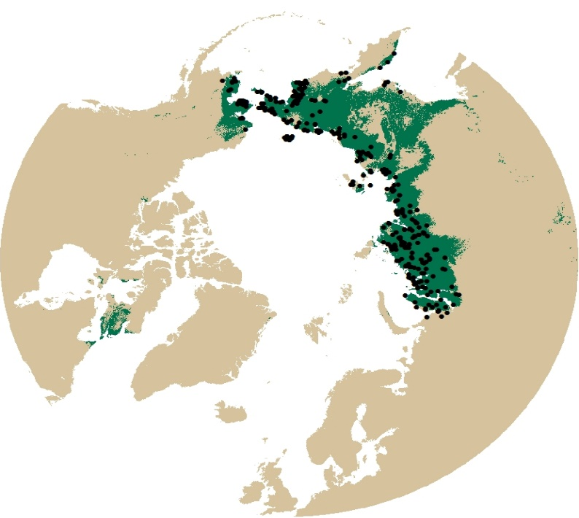
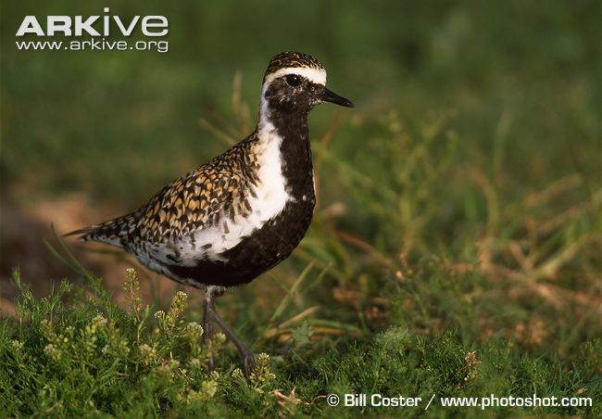
Growing need for ecological modelling
BCCVL predicting change in distributions expected with climate change
Hannah S. Wauchope et al. Rapid climate-driven loss of breeding habitat for Arctic migratory birds, Global Change Biology (2016).
Outputs
Otomes

Slide 8
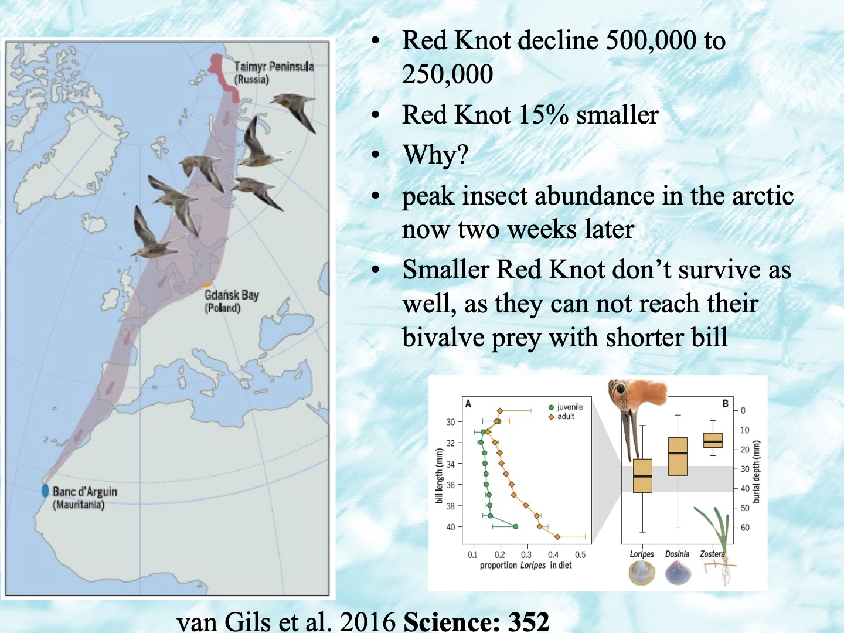

Slide 9


Species Distribution modelling
“all models are wrong, some are useful” George Box
Notes:
I will now pass you on to Dr Emilia Decker who will walk you through how you can conduct Species distribution models within the BCCVL platform.

Slide 10




Slide 11
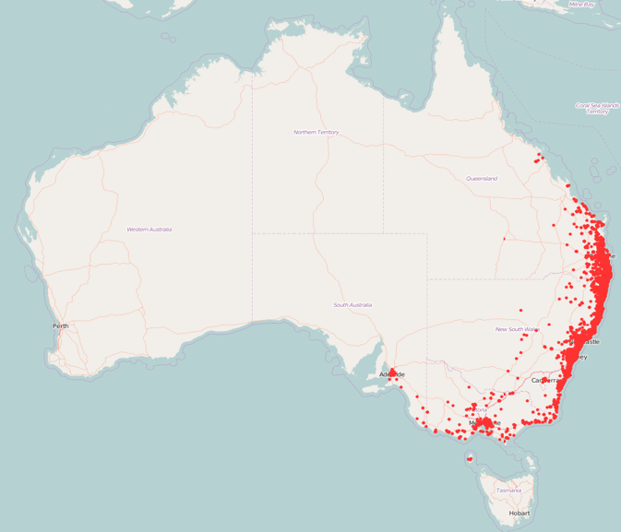
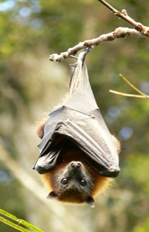






Why do species occur in some places, but not in others?
Photo: ©Shane Ruming
Abiotic factors
Biotic interactions
Dispersal limitations
Notes:
One of the most fundamental questions in ecology is ‘why do species occur in certain places, but not in others?’. For each individual species, there is a range of factors that form the answer to this question. These factors broadly fall into three categories: biological factors, which refers to all living organisms that might interact with the species of interest, for example as prey, competitors or as providers of the living environment. Abiotic factors, which refer to the non-living parts of the environment, such as temperature, rainfall, or water salinity. And the third factor is dispersal barriers or the ability of a species to reach a certain place.

Slide 12
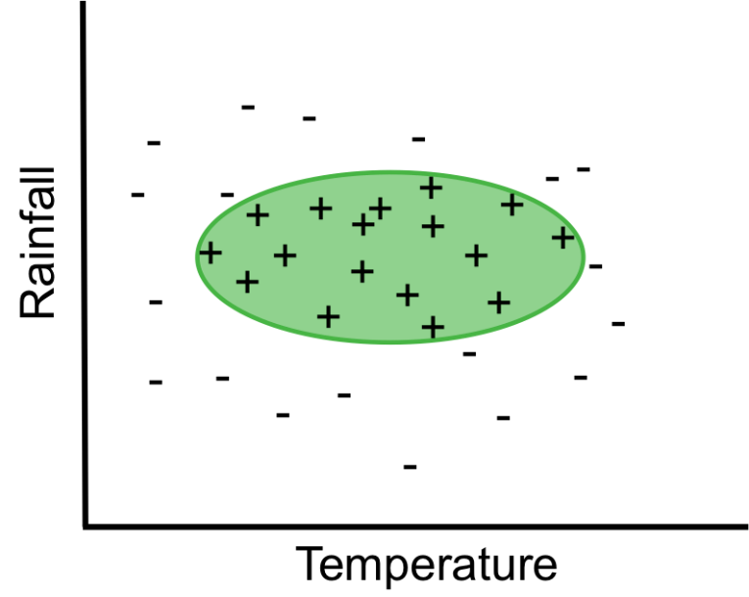
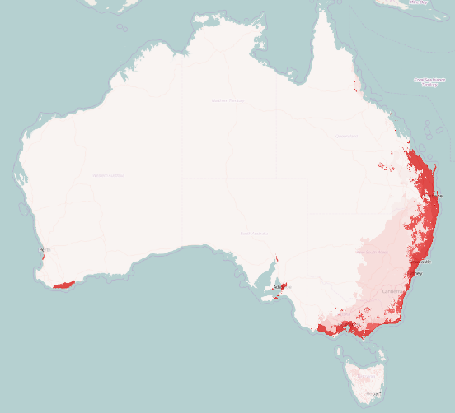
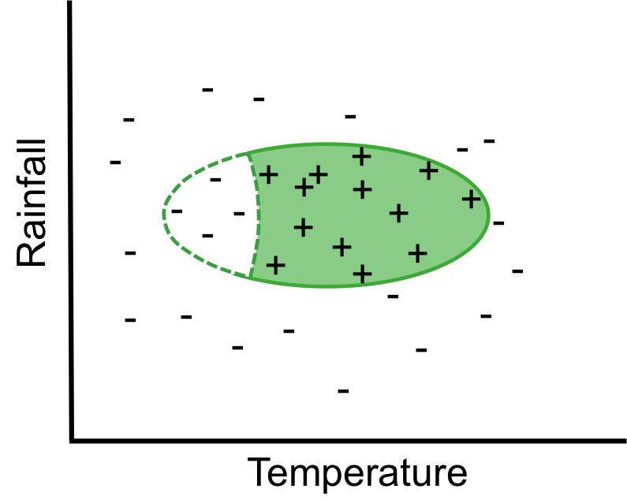
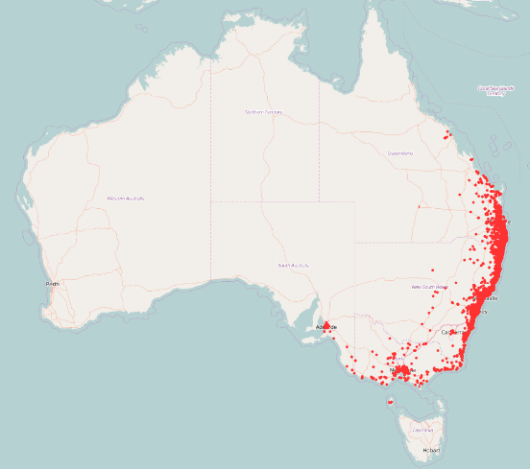
Species Distribution Modelling
aka Environmental Niche Modelling
Fundamental
Niche
or
potential distribution
Potential distribution
Realized niche
or
actual distribution
Actual distribution
Notes:
Species distribution models mostly focus on the environmental conditions to determine locations that are suitable for a species to survive. This type of modeling is therefore also called environmental niche or ecological niche modelling.
When we talk about a species’ environmental niche, we refer to the set of environmental conditions in which a species can survive and persist.
(C) The fundamental niche of a species refers to the environmental conditions where a species can occur, and assumes that the species only occurs there and nowhere else. So in this example, a species was found to occur in places where it is not too hot and not too cold, and not too wet or too dry.
However, a species is not necessarily found in every location that has suitable environmental conditions. This is because the distribution of a species is also influenced by biotic factors, and can thus be limited by the presence of a predator, or the absence of food. The area that is actually occupied by a species is referred to as the realized niche.
When we look at species distributions plotted on a map, the realized niche refers to the places where we have observed a species and thus know it definitely occurs; this is the species’ actual distribution. The fundamental niche indicates areas that have similar suitable environmental conditions, and this is thus referred to as a species’ potential distribution.
Because species distribution models are useful in highlighting both actual and potential distributions, they can be used for various applications:

Slide 13
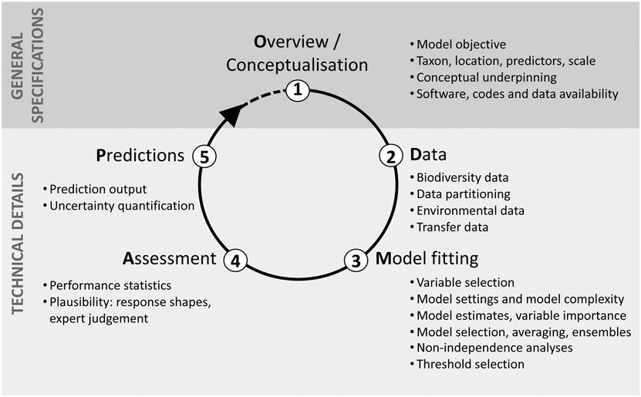
Overview of the process
Zurell, et. al.(2020), A standard protocol for reporting species distribution models. Ecography, 43: 1261-1277. https://doi.org/10.1111/ecog.04960

Slide 14
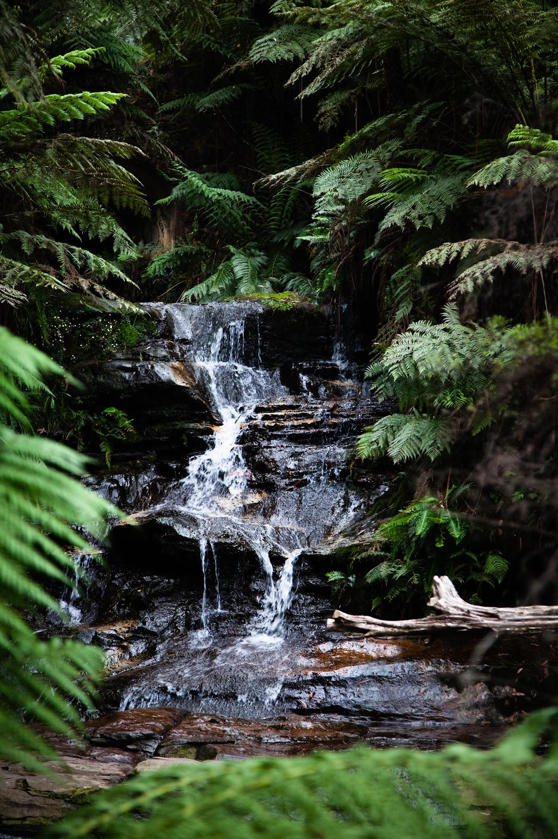
Before you get started, conceptualisation
Define your question, form a hypothesis first
2. Confirm why you are investigating?
Learning for learning’s sake (pure science)
Engagement
Serendipity
Track change - inform on adaptive or state dependent management
Conservation? - then confirm your model can change things
3. Identify purpose
AraújoM. B. et al. 2019. Standards for distribution models in biodiversity assessments. – Sci. Adv.5
Explanation
Mapping
Transfer (projection)

Slide 15
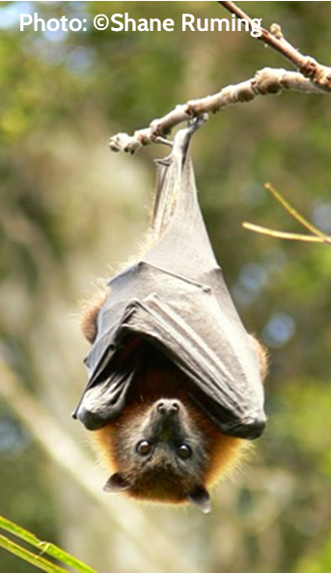
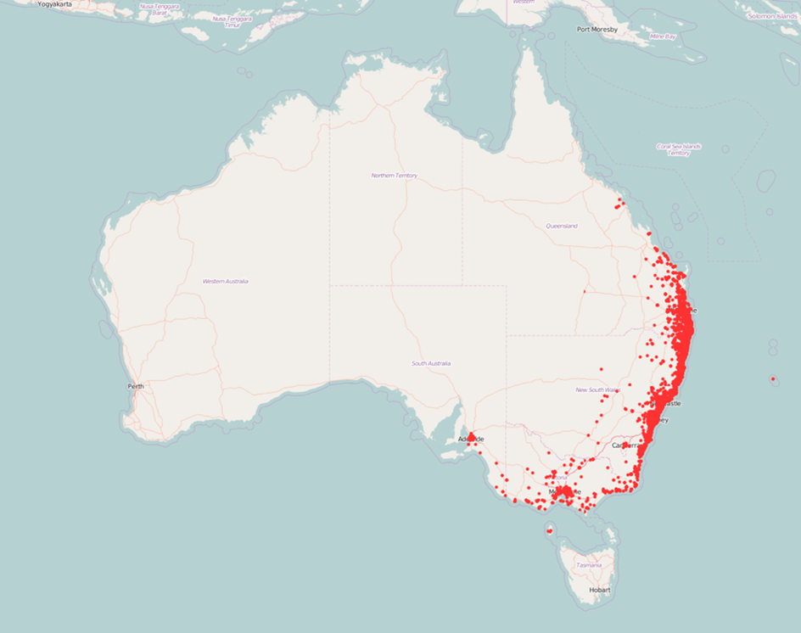
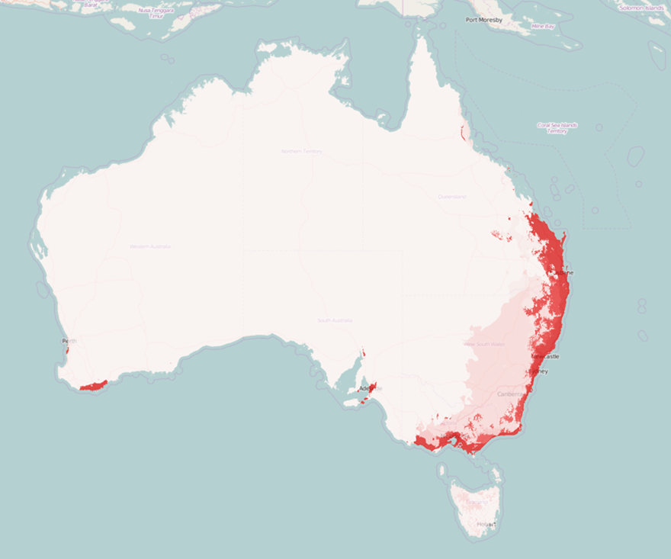
Species Distribution Model
Species
data
Environmental data
Algorithm
Notes:
To calibrate a correlative species distribution model we need two types of input data: species occurrences, and measurements of a suite of environmental variables, such as temperature and rainfall.
These two types of data are then put into an algorithm to find associations between the known occurrences of a species and the environmental conditions at those sites, so we can identify the environmental conditions that are suitable for a species to survive. When we talk about an algorithm, we mean the actual method that you use to determine the probability of occurrence based on a set of environmental data. Which algorithm is most suitable is dependent on the type of data that you have, but it also goes the other way around: based on your preferred algorithm there are different optimal methods to generate your data (for example pseudo-absence data – which we’ll get into shortly).

Slide 16
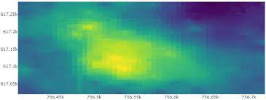




Geographic
models
+
Geographic models
+
+
+
+
+
+
+
+
latitude
+
+
+
+
+
longitude
Presence only
No environmental data
Inverse Distance weighting
Notes:
Geographic models only use presence data, and no environmental data(C). The models use simple algorithms that predict that a species is present at sites within a certain shape or distance around the occurrence points (C). An example is the convex hull model that draws a shape around the outermost occurrence points (a convex hull) and predicts that a species can be present anywhere within the convex hull, and will be absent outside the convex hull. Because geographic models do not take into account the environmental conditions of occurrence sites, they are often not considered as true species distribution models. But they provide a good method to get a quick idea of the spatial extent of a species.

Slide 17


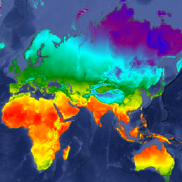
Bioclim
Profile
models
v1 min
v1 max
Profile models
+
v2 max
+
+
+
+
+
+
+
+
+
+
Environmental variable 2
+
+
+
+
+
+
+
+
+
+
+
Presence only
v2 min
Need environmental data
Environmental variable 1
NOTES
> continuous variables only
> no interactions
https://developers.google.com/earth-engine/datasets
Notes:
Profile models are the most basic true species distribution models. Like geographic models, they also use only occurrence data, but these models do use environmental data as well. The best known profile method is Bioclim (C) which is considered as the first species distribution model. Bioclim constructs the suitable environmental space as a bounding box around the minimum and maximum values of the environmental variables for all occurrences (C). The green area (C) within the bounding box represents the suitable environmental conditions for a species to survive. With multiple variables, this results in a multi-dimensional rectilinear envelope ((C)
Profile models can only handle continuous predictors, and do not take into account interactions between environmental variables.

Slide 18

Ecological Niche Modelling
2
Correlative
Correlates species occurrences with environmental variables
Current distribution
Future distribution

Slide 19
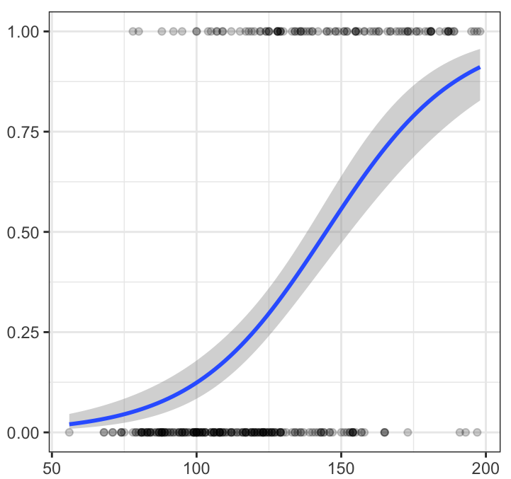
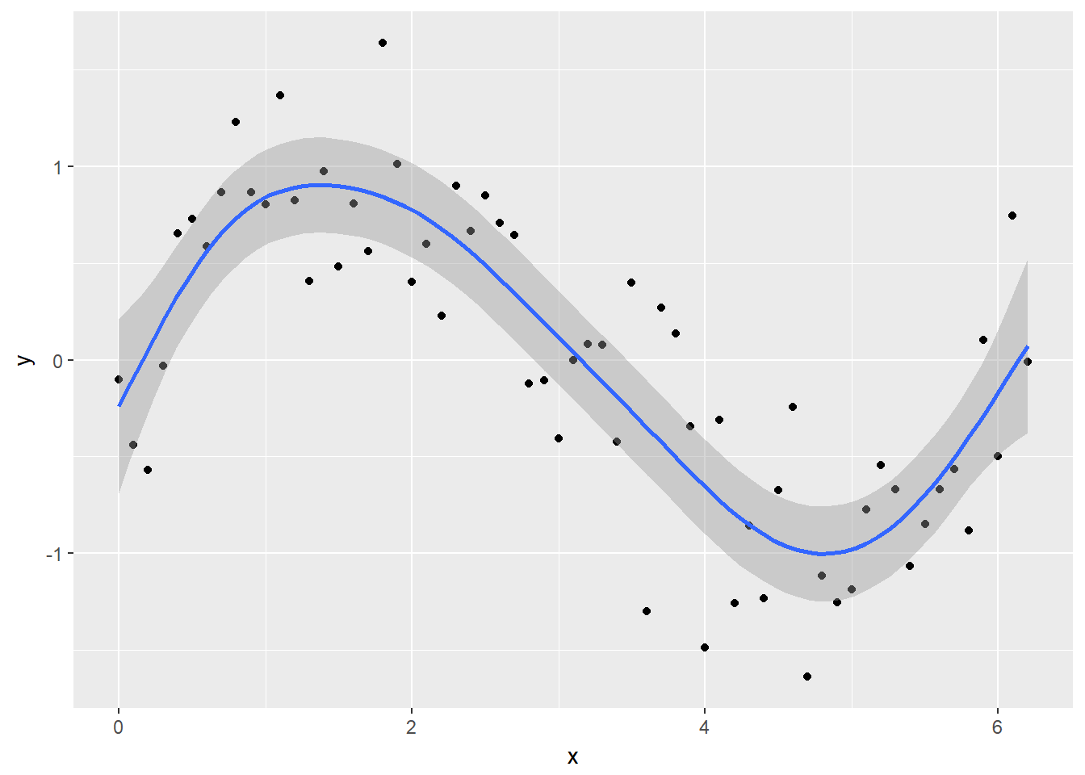
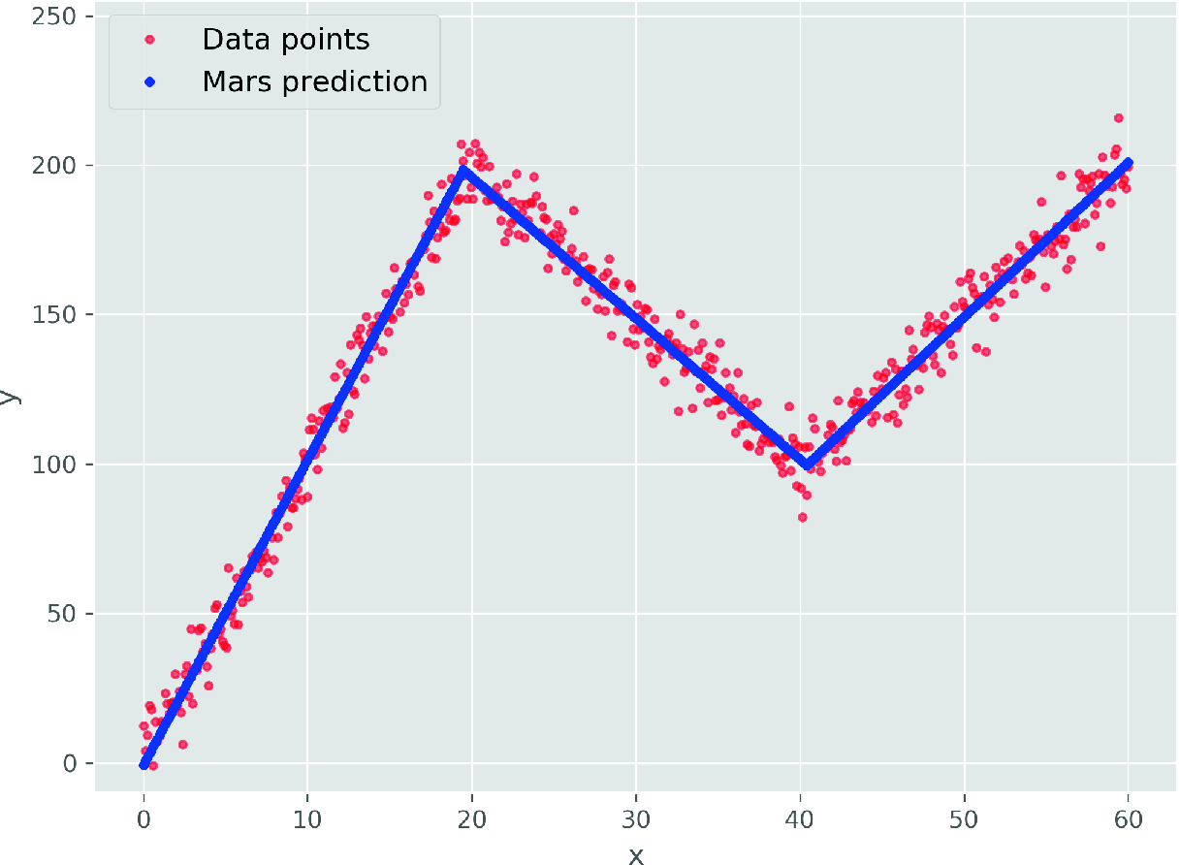
Binomial GLM
Best for explanation / inference
Need a response variable. Presence and (pseudo)absence response variable, or abundance
Continuous & categorical environmental predictors
Geographic models
http://www.sthda.com/english/articles/36-classification-methods-essentials/151-logistic-regression-essentials-in-r/
Statistical
models
Multivariate Adaptive Regression Splines
Generalized Additive Model
Knot
Shen & Wang (2020) https://doi.org/10.1007/978-3-030-32029-4_27
http://environmentalcomputing.net/intro-to-gams/
Notes:
Statistical regression models need both presence and absence data. These models also use environmental data, and the algorithms use all the data available to estimate the coefficients of the environmental variables, and they construct a function that best describes the effect of those variables on species occurrence. Statistical regression models can handle both continuous and categorical predictors and also include interactions between those variables. Three popular statistical algorithms for species distribution modelling are generalized linear models, generalized additive models and multivariate adaptive regression splines.

Slide 20
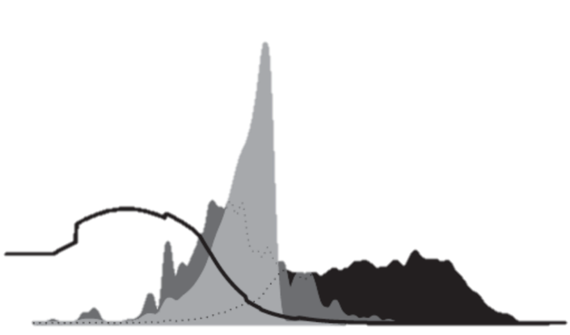
> presence background
Probability density
Often best at prediction
Need environmental data
Maxent
Environmental variable
Merow et al. 2013
> presence & (pseudo) absence
Tree-based models
0
1
0
0
0
1
> presence & (pseudo) absence
Machine learning models
Artificial Neural Networks
Notes:
The last group is machine learning models, which also use environmental data. While statistical models use all data to build the function, machine learning models typically train the model on one part of the dataset and the other part to assess the accuracy of the model. Most machine learning models use both presence and absence data, but there is one exception.
This is Maxent, which predicts species occurrences by finding the distribution that is most spread out, or the closest to uniform, while taking into account the limits of the environmental variables of known locations.
Then we have tree-based models, which predict species occurrence probabilities based on decision trees, and the last machine learning model available in the BCCVL are artificial neural networks.

Slide 21
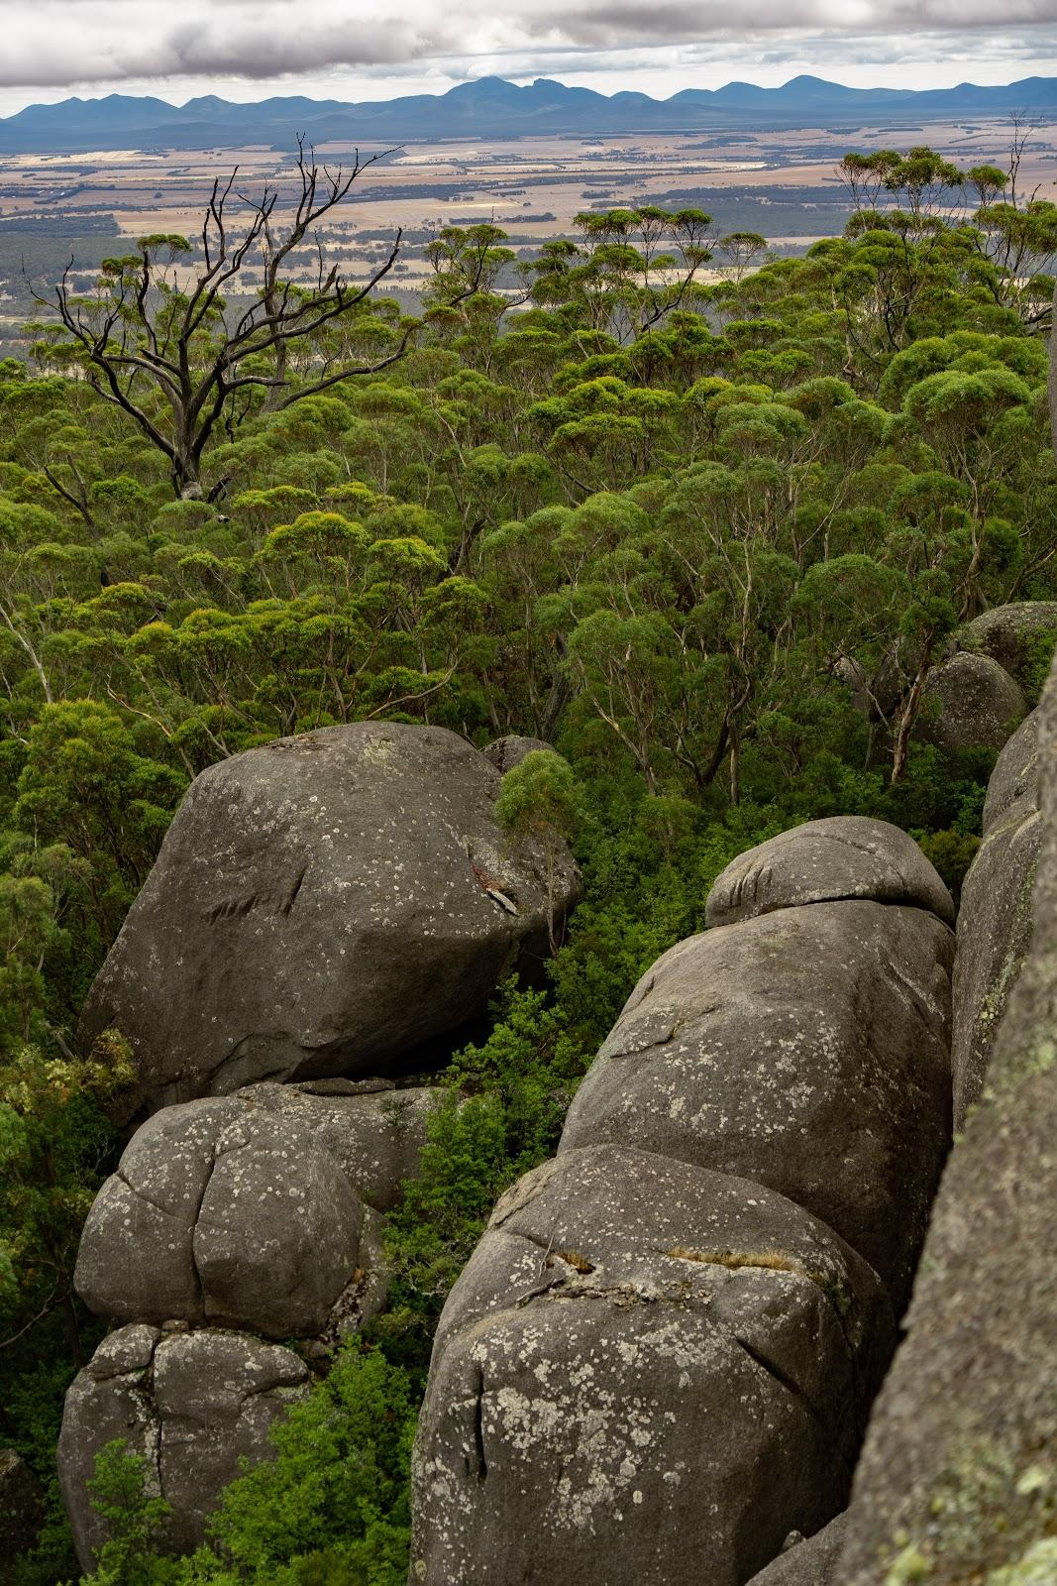
Plan so you avoid questionable research practices
Most important when your purpose is explanation
Form hypotheses or expectations before you start
Avoid hypothesizing after your results are known
Avoid presenting only favorable evidence while concealing unfavorable evidence
Avoid relentless analysis or indiscriminate testing of associations between variables to obtain statistically significant results
When your purpose is mapping, or projection iterative modelling works so long as you validate model outputs adequately

Slide 22
Does available data match your question?
Systematic sampling with same method in each locations, a well defined sampling protocol and zeros are recorded when a species is not detected.
Structured monitoring where zeros and sampling effort can be inferred
Unstructured monitoring where zeros and possibly sampling effort can be inferred
Opportunistic data where method and sampling are largely unknown
Best
Worst

Slide 23
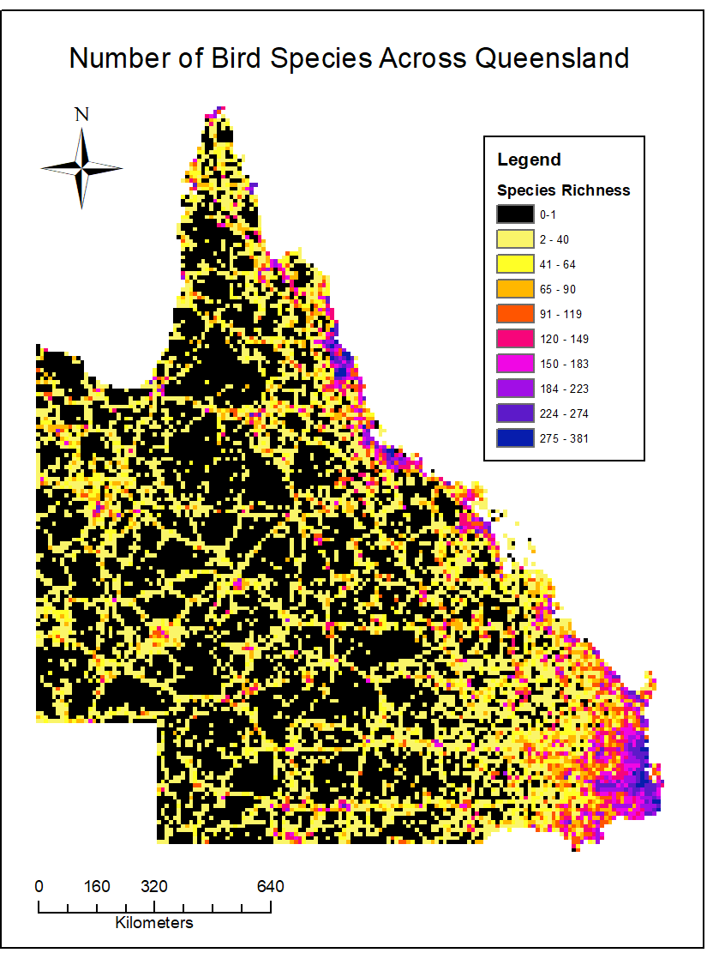
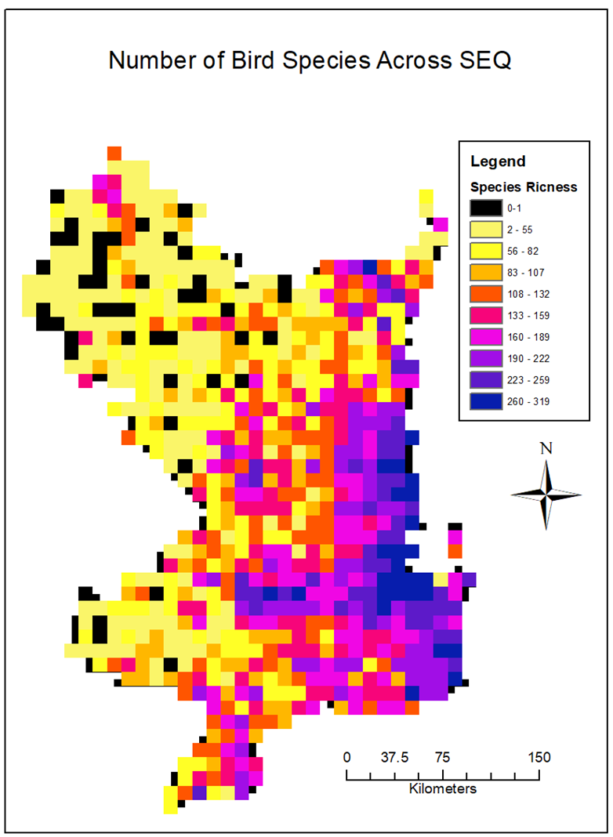
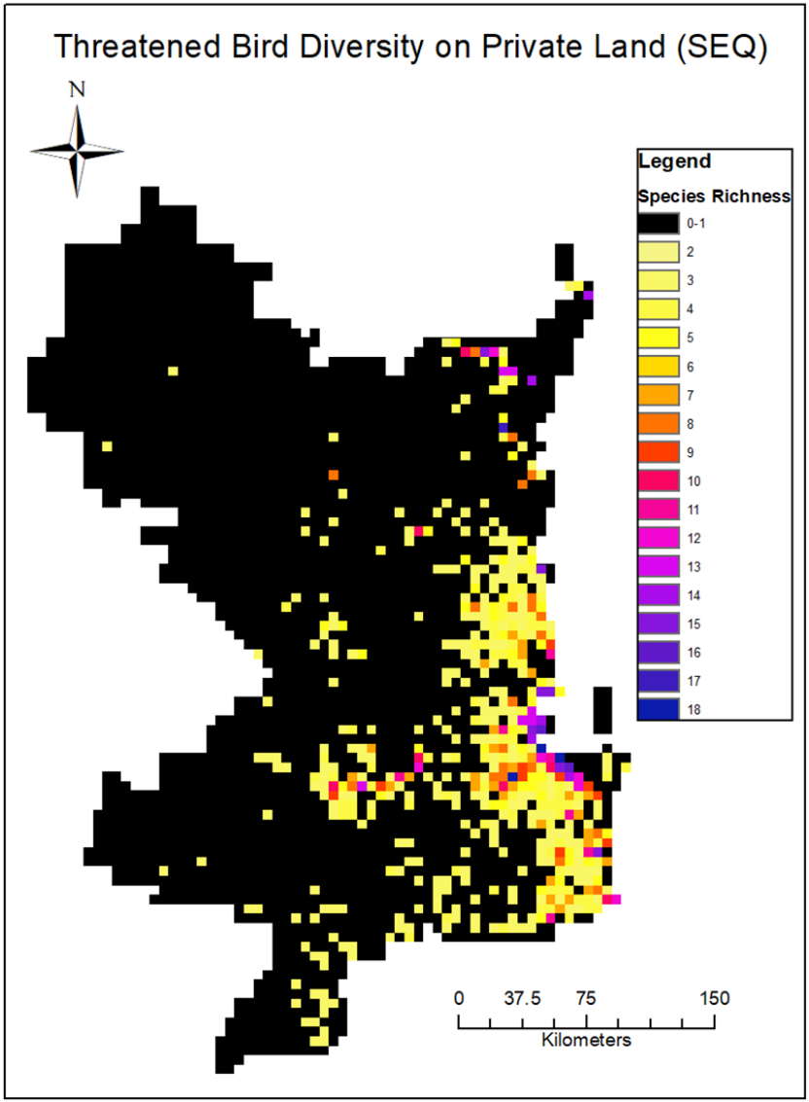
Sampling bias
Notes:
However, if you look up a distribution map of a species, it often shows a range rather than dots on a map. So, how do we go from specific places where individuals of a species have been observed to producing a map that gives an estimate of the distribution of that species? This is where species distribution models come into play.

Slide 24
Geographic
models
Profile
models
?
Statistical regression
models
Machine learning
models
Notes:
There are quite a lot of different algorithms available to model species distributions. Which ones to choose depends on the your question, on the available data, and your understanding of your species and its ecology

Slide 25

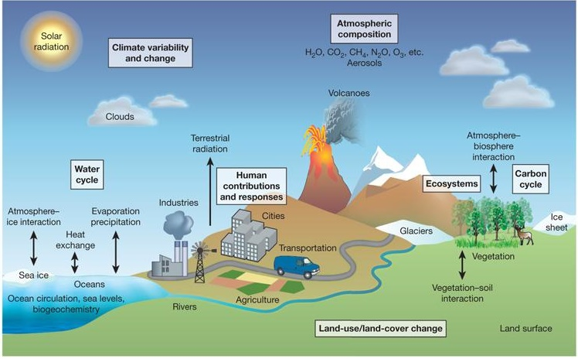
Climate Change projections
Moss et al. (2010) Nature 463: 747-756
Notes:
Based on the knowledge that we have about physical and chemical processes, and interactions between the atmosphere, the biosphere, the land and the oceans, scientists have built models that represent the earth’s climate system, as shown in this diagram.
These models include natural processes, such as the radiation that the earth receives from the sun, but also human impacts such as the emission of anthropogenic greenhouse gases.

Slide 26


Representative Concentration Pathway (RCP)
1200
Global energy balance
= absorption - radiation
RCP 8.5 - 4.9 ℃
RCP 6 - 3.0 ℃
CO2-equivanent (ppm)
600
0
RCP 4.5 - 2.4 ℃
RCP 2.6 - 1.5 ℃
Absorption
Radiation
2000 2025 2050 2075 2100
Notes:
There are four different RCP scenarios. The numbers refer to radiative forcing measured in watts per square meter, by the year 2100.
This represents the global energy balance, measured as the difference between the amount of energy from the sun that the earth absorbs and the energy that is radiated back to space.
If there is more energy absorbed than radiated back to space, the earth will be warming.

Slide 27

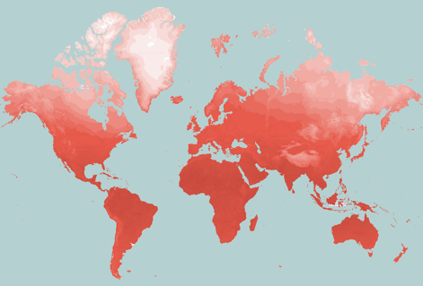
Representative Concentration Pathway
General
Circulation
Model
Potential future
global warming scenarios
Projection of
future climate
10
8
6
RCP 8.5
Radiative forcing (W/m²)
RCP 6
4
2
0
RCP 4.5
RCP 2.6
2000 2025 2050 2075 2100
Notes:
So, the RCPs give us an indication what consequences our actions can have, and showcase different scenarios with regards to global warming.
These are used in combination with General Circulation Models, or Global Climate Models to predict future climate, thus what temperatures and rainfall values we can expect in particular regions.

Slide 28








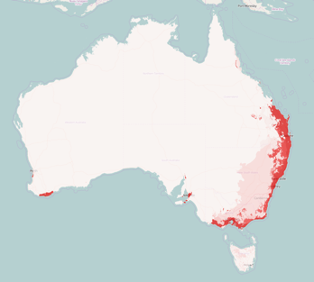
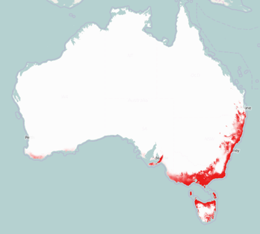

Climate Change Model
Species Distribution Model
Climate Change
Projection
Representative
Concentration
Pathway
General
Circulation
Model
Predicted distribution under current climate
Predicted distribution under future climate
Notes:
So how do we combine species distribution models with climate change projections?
You start with building a species distribution model, so you select your species data and environmental data, and use an algorithm to build a species distribution model.
The output will give you the predicted distribution under current climate conditions.
You then add another step to the model, in which you take the outcomes of your species distribution model under current climate conditions, and project these with future climate datasets to obtain a prediction for where your species could occur in the future under a particular climate change scenario.

Slide 29
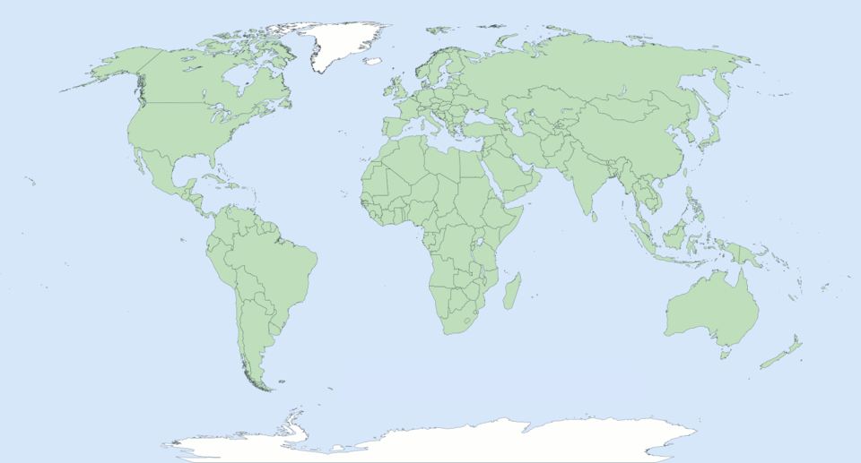
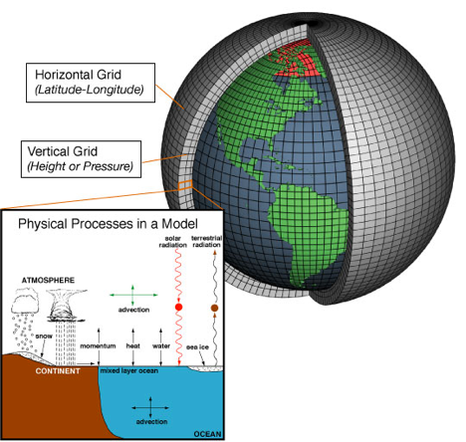
General Circulation Models (GCM)
Beaumont, L. J., Hughes, L., & Pitman, A. J. (2008). Why is the choice of future climate scenarios for species distribution modelling important?. Ecology letters, 11(11), 1135-1146. https://doi.org/10.1111/j.1461-0248.2008.01231.x
NOAA 2012
Notes:
Across the world, there are lots of different research groups, who have constructed one or more general circulation models.
You might wonder why there are so many different models, can we not just use one?
Well, the basic structure of these models is the same, but each of the research groups make different choices about which sub-models they include and which earth system processes they want to emphasize.

Slide 30
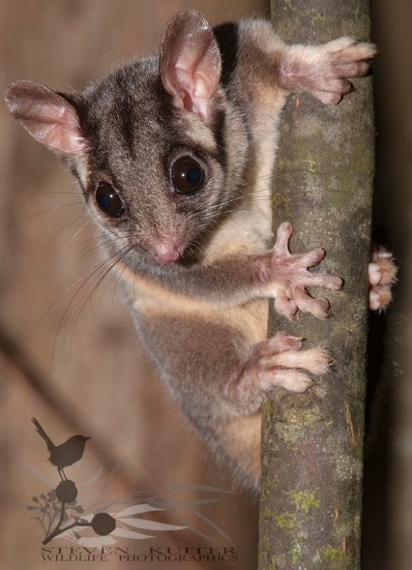
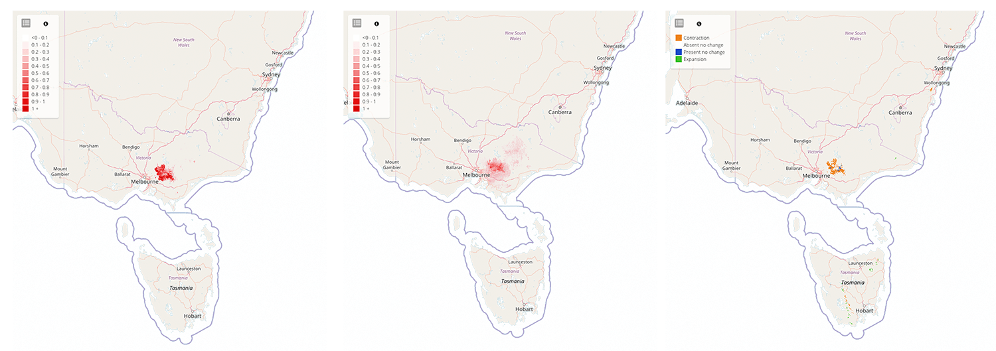
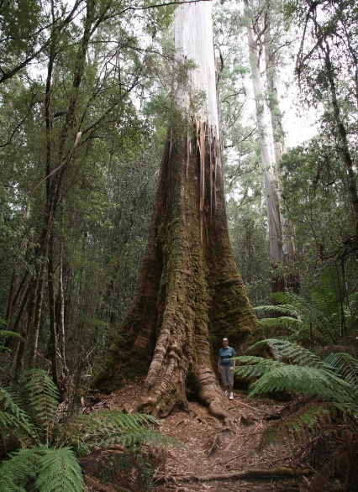
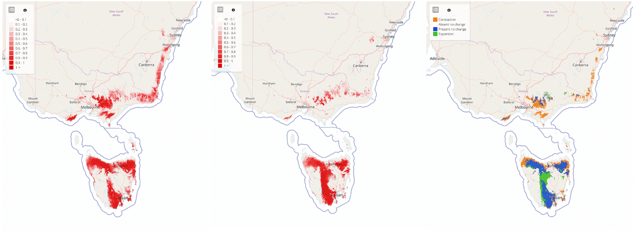
Conservation example: climate change impacts on threatened species habitat
current
2075
RCP 8.5
Range change
Leadbeater’s Possum
Gymnobelideus leadbeateri
current
2075
RCP 8.5
Range change
Mountain Ash
Eucalyptus regnan
Notes:
So if we combine data on RCPs, global circulation models and current species distribution we can estimate how a species habitat will respond to climate change.
Is is important that we understand how species will respond to climate change and other human impacts so we can prioritize conservation and management efforts.
For example, the Leadbeater’s Possum which is sadly critically endangered. It relies on a specific eucalypt species to survive - the Mountain Ash, which we modelled in the demonstration.
By conducting the models in the BCCVL we can determine where current suitable habitat is now, which is shown in the first map here.
We can show where suitable habitat might be in 2075 based on our current lack of climate action, shown n the second map.
And we can show the change in habitat range, where Orange shows a range contraction, the blue shows areas of no change and Green shows a range expansion in suitable habitat.

Slide 31
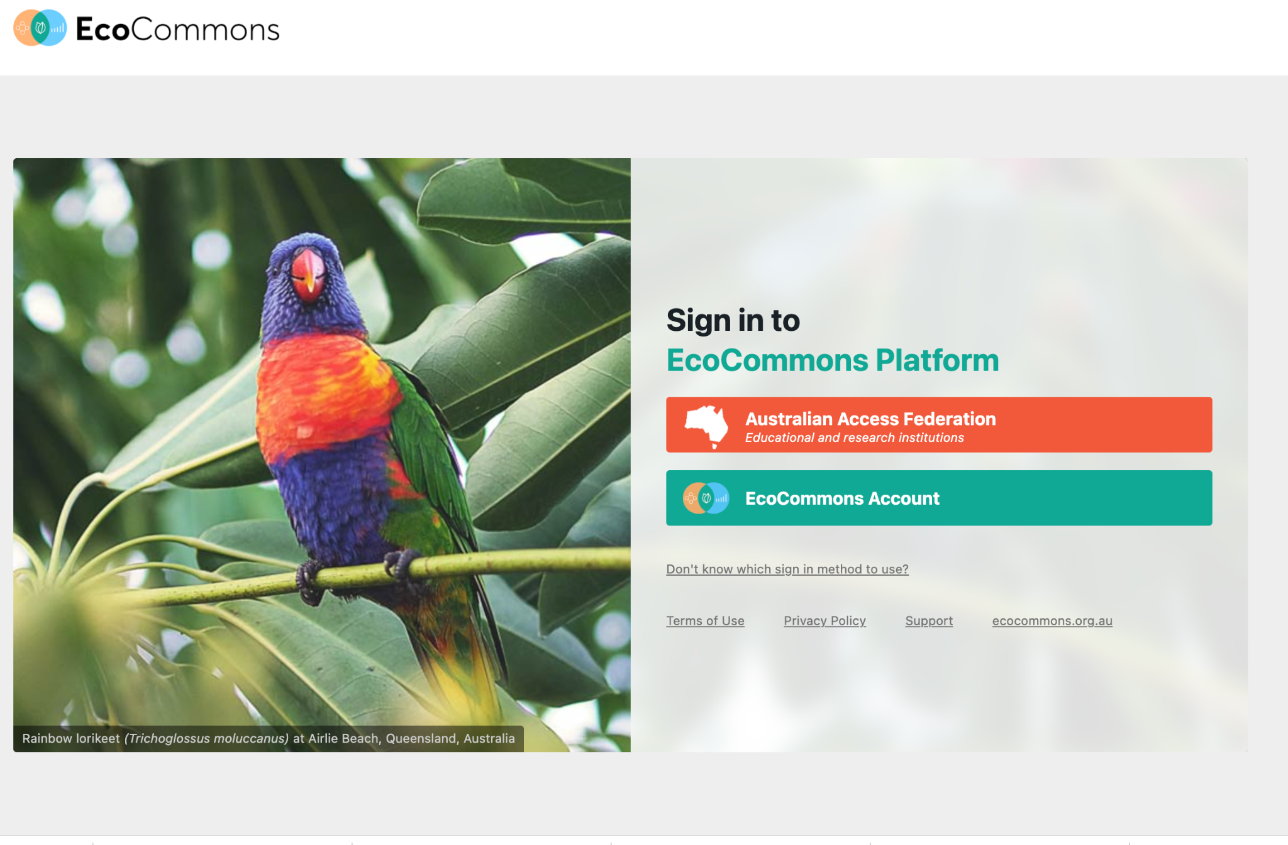
Notes:
Rob

Slide 32

Notes:
Rob

Slide 33

Notes:
Rob

Slide 34

Notes:
Rob

Slide 35

Notes:
Rob

Slide 36

Notes:
Rob

Slide 37

Notes:
Rob

Slide 38

Notes:
Rob

Slide 39

Modelling wizards
Notes:
Rob

Slide 40

Notes:
Rob

Slide 41

Notes:
Rob

Slide 42

Notes:
Rob

Slide 43


Notes:
Rob

Slide 44

Notes:
Rob

Slide 45

Notes:
Rob

Slide 46

Notes:
Rob

Slide 47


Notes:
Rob

Slide 48

Notes:
Rob

Slide 49

Notes:
Rob

Slide 50

Notes:
Rob

Slide 51

Notes:
Rob

Slide 52

Notes:
Rob

Slide 53

Notes:
Rob

Slide 54

Notes:
Rob

Slide 55

Notes:
Rob

Slide 56
BEWARE!
Uncertainties in species distribution models:
We have only scratched the surface of the variety of things you should consider to get the best results
Models are only a representation of the real world
Species interactions
Limited understanding of species capability to adapt to change
Other impacts like land use changes
Notes:
Before you go and explore how climate change might affect your species of interest, I would like to give you some food for thought and briefly discuss the uncertainties regarding species distribution models under future climate change projections.
Be aware that models are only a representation of the real world, based on our understanding of species and their environment. Because we do not have detailed information about the tolerances to different environmental variables for each species, we make assumptions based on their current occurrence sites.
We are also limited in our understanding about how both animals and plants will adapt to changes in climate and their environment, and whether they are able to move to new areas with suitable environmental conditions.
Another point to note is that species distribution models often focus on predicting the current and future distribution of one or maybe a few species, not taking into account the interactions between species. While some species might be able to adapt to climate change, if their food source goes extinct or disperses to other areas that might indirectly affect that species as well.
Another important factor of both species and environmental data that is used for a species distribution model is scale. Climate variables are typically modelled at larger resolutions like 10 km grids, while species might respond at much smaller scales, for example if their home range is smaller than the climate data resolution.
Lastly, of course climate change is not the only factor that affects the distribution of species. Other impacts such as changes in land use can also drive species to go extinct or move to other areas, for example if essential habitat is cleared as a result of deforestation or urbanisation.

Slide 57
Climate projections can be great for raising awareness
Hannah S. Wauchope et al. Rapid climate-driven loss of breeding habitat for Arctic migratory birds, Global Change Biology (2016).
Outputs
Otomes

Slide 58


Powerful Owl species distribution model
Mapping example more complex
Best predictors, fine scale related to ecology
Dense vegetation / forest in riparian areas
Photo: Kristen Hardy

Slide 59


Take home messages
Finer scale predictions for use in planning are possible
Predictions can be summarized:
2/3 of the time species is outside existing protected areas

Slide 60




Who is your audience?
Don’t give your audience results that can be used at a scale they were not intended.

Slide 61




Visualisation of uncertainty
Lots of data from many sources
Coming soon!
Community modelling / GDM
Baudin’s Black Cockatoo (probability of occurrence)

Slide 62



Huge time savings to run analyses
Greater Sooty Owl by Amanda Robertson
https://www.ecocommons.org.au/how-australian-mega-fires-impacted-the-superb-lyrebird-and-greater-sooty-owl/
We were able to come up with very similar values to published research on how much suitable habitat was burned by the 2019/2020 megafires
But it took us 15 mins to run the models!
Notes:
Rob
One of the problems that many researchers, research hubs and environmental NGOs in Australia were looking into was how much suitable habitat was left for certain species after the megafires in 2019/2020. We developed a use case to demonstrate how powerful EcoCommons is by using data on one of the species investigated called the Greater Sooty Owl and data on fire intensity. We run multiple models that performed differently well and yet our results were very close to those of the published research - but it only took us 15mins to run the models.

Slide 63

We would welcome your feedback
Press feedback button to tell us what changes you want & to highlight anything that is not working.
The site may slow down or go down as our software developers work on it. Public release Nov 2022
To learn basics of R coding
https://datacarpentry.org/R-ecology-lesson/
Educational Materials
&
Use cases
https://www.ecocommons.org.au/
Notes:
You can find out more about EcoCommons on our webpage: ecocommons.org.au.
To raise awareness of the current extinction crisis, we launched our webpage on Threatened Species Day which remembers the extinction of the Tasmanian tiger (Thylacinus cynocephalus) in 1936. EcoCommons is committed to help researchers and policy-decision makers stop further extinctions by empowering them with data and analytics to do better informed management of Australia’s 1900+ threatened species.
On our webpage you can find out:
How you can become an EcoCommons Pioneer and be the first to explore and test new tools!
Follow our journey - sign up for our newsletter
Follow us on twitter or LinkedIn: @EcoCommonsAus
Collaborate with us!

Slide 64

Explore EcoCommons webpage
Follow our Journey
https://www.ecocommons.org.au/
Notes:
You can find out more about EcoCommons on our webpage: ecocommons.org.au.
To raise awareness of the current extinction crisis, we launched our webpage on Threatened Species Day which remembers the extinction of the Tasmanian tiger (Thylacinus cynocephalus) in 1936. EcoCommons is committed to help researchers and policy-decision makers stop further extinctions by empowering them with data and analytics to do better informed management of Australia’s 1900+ threatened species.
On our webpage you can find out:
How you can become an EcoCommons Pioneer and be the first to explore and test new tools!
Follow our journey - sign up for our newsletter
Follow us on twitter or LinkedIn: @EcoCommonsAus
Collaborate with us!

Slide 65


We gratefully acknowledge:

Slide 66



Thank You

